Slide 1
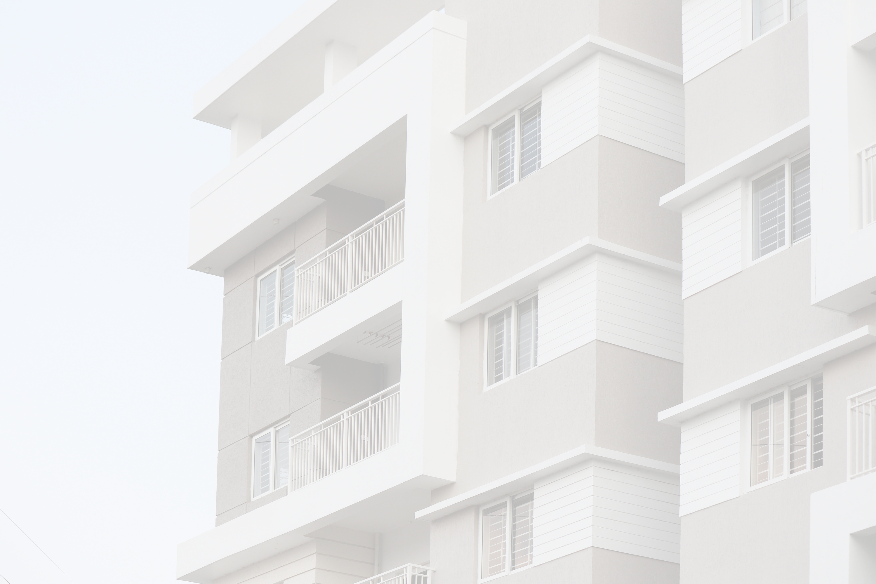
Analysis & Design of Algorithms

Slide 2
CONTENT
01
Introduction
02
Asymptotic notations
03
Mathematical Analysis of non recursive algorithm
04
Mathematical Analysis of recursive algorithm
05
Selection sort & Bubble sort
06
Sequential search
07
Brute Force string Matching

Slide 3

INTRODUCTION
What is an Algorithm?
An Algorithm is a sequence of an instructions/commands for solving a given problem.
Representation of Algorithm
We can represent Algorithms using:
Pseudocode: A Pseudocode is defined as a step-by-step description of an algorithm. Pseudocode does not use any programming language in its representation instead it uses the simple English language text as it is intended for human understanding rather than machine reading.
Flowcharts: Visual diagrams illustrating the flow of the algorithm with decision points, paths, and conclusions.

Slide 4

An algorithm must satisfy the following criteria:
1. Input: An algorithm should have zero or more but should be a finite number of inputs. We can also say that it is essential for any algorithm before starting. Input should be given to it initially before the begins.
2. Output: An algorithm must give at least one required result from the given set of input values. These output values are known as the solution to a problem.
3. Definiteness: Each step must be clear, unambiguous, and precisely defined.
4. Finiteness: Finiteness means should be terminated after a finite number of steps. Also, each step should be finished in a finite amount of time.
5. Effectiveness: Each step of the Algorithm must be feasible i.e., it should be practically possible to perform the action. Every Algorithm is generally expected to be effective.

Slide 5
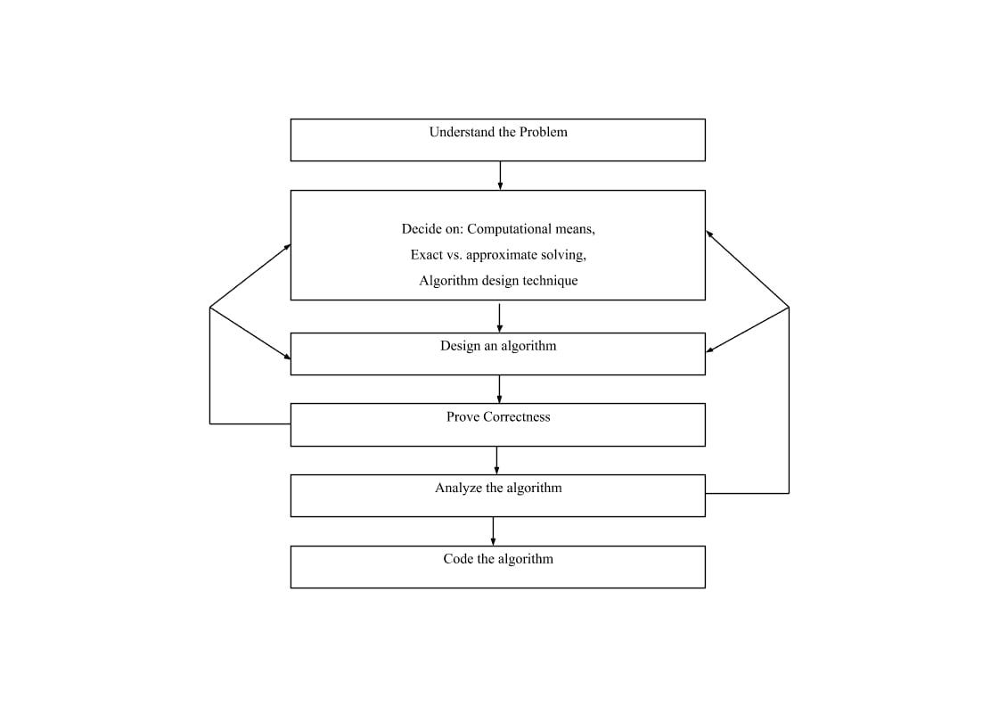

FUNDAMENTALS OF ALGORITHMIC PROBLEM SOLVING
(i) Understanding the Problem
This is the first step in designing of algorithm.
Read the problem’s description carefully to understand the problem statement completely.
Ask questions for clarifying the doubts about the problem.
Identify the problem types and use existing algorithm to find solution.

Slide 6
(ii) Decision making
Choosing between Exact and Approximate Problem Solving:
The next principal decision is to choose between solving the problem exactly or solving it approximately.
An algorithm used to solve the problem exactly and produce correct result is called an exact algorithm.
If the problem is so complex and not able to get exact solution, then we have to choose an algorithm called an approximation algorithm
Algorithm Design Techniques
An algorithm design technique (or “strategy” or “paradigm”) is a general approach to solving problems algorithmically that is applicable to a variety of problems from different areas of computing.
Implementation of algorithm is possible only with the help of Algorithms and Data Structures
Algorithmic strategy / technique / paradigm are a general approach by which many problems can be solved algorithmically. E.g., Brute Force, Divide and Conquer, Dynamic Programming, Greedy Technique and so on.

Slide 7
(iii) Methods of Specifying an Algorithm
There are three ways to specify an algorithm. They are:
a. Natural language: It is very simple and easy to specify an algorithm using natural language.
b. Pseudocode: Pseudocode is a mixture of a natural language and programming language constructs. Pseudocode is usually more precise than natural language.
c. Flowchart: Flowchart is a graphical representation of an algorithm. It is a method of expressing an algorithm by a collection of connected geometric shapes containing descriptions of the algorithm’s steps.
(iv) Proving an Algorithm’s Correctness
Once an algorithm has been specified then its correctness must be proved
A common technique for proving correctness is to use mathematical induction because an algorithm’s iterations provide a natural sequence of steps needed for such proofs.

Slide 8
(v) Analyzing an Algorithm
For an algorithm the most important is efficiency. In fact, there are two kinds of algorithm efficiency. They are:
Time efficiency, indicating how fast the algorithm runs, and
Space efficiency, indicating how much extra memory it uses.
The efficiency of an algorithm is determined by measuring both time efficiency and space efficiency.
(vi) Coding an Algorithm
The coding / implementation of an algorithm is done by a suitable programming language like C, C++,JAVA.
Implementing an algorithm correctly is necessary. The Algorithm power should not reduce by in efficient implementation.
It is very essential to write an optimized code (efficient code) to reduce the burden of compiler.

Slide 9
FUNDAMENTALS OF THE ANALYSIS OF ALGORITHM EFFICIENCY
1.1 Analysis Framework
There are two kinds of efficiencies to analyze the efficiency of any algorithm. They are:
Time efficiency, indicating how fast the algorithm runs, and
Space efficiency, indicating how much extra memory it uses.

Slide 10
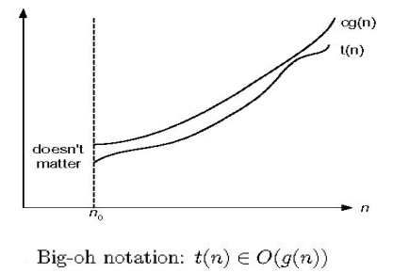
ASYMPOTIC NOTATIONS
Asymptotic Notations: Asymptotic notation is a way of comparing functions that ignores constant factors and small input sizes. Three notations used to compare orders of growth of an algorithm’s basic operation count are: O, Ω, Θ notations
Big Oh- O notation: A function t(n) is said to be in O(g(n)), denoted t(n) ∈O(g(n)), if t(n) is bounded above by some constant multiple of g(n) for all large n, i.e., if there exist some positive constant c and some nonnegative integer n0 such that
t(n) ≤ cg(n) for all n ≥ n0

Slide 11
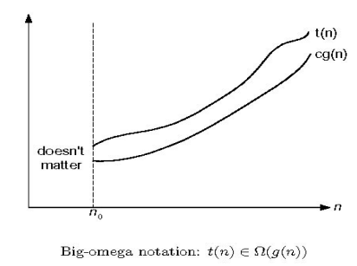
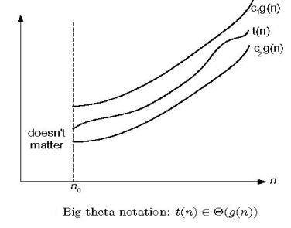
2.Big Omega- Ω notation: A function t (n) is said to be in Ω (g(n)), denoted t(n) ∈ Ω (g (n)), if t (n) is bounded below by some constant multiple of g (n) for all large n, i.e., if there exist some positive constant c and some nonnegative integer n0 such that t(n) ≥ cg(n) for all n ≥ n0
3.Big Theta- Θ notation Definition: A function t (n) is said to be in Θ(g (n)), denoted t(n) ∈ Θ(g (n)), if t (n) is bounded both above and below by some constant multiple of g (n) for all large n, i.e., if there exist some positive constant c1 and c2 and some nonnegative integer n0 such that
c2 g (n) ≤ t (n) ≤ c1 g (n) for all n ≥ n0

Slide 12
Mathematical analysis (Time Efficiency) of Non-recursive Algorithms
General plan for analyzing efficiency of non-recursive algorithms:
1. Decide on parameter n indicating input size
2. Identify algorithm’s basic operation
3. Check whether the number of times the basic operation is executed depends only on the input size n. If it also depends on the type of input, investigate worst, average, and best case efficiency separately.
4. Set up summation for C(n) reflecting the number of times the algorithm’s basic operation is executed.
5. Simplify summation using standard formulas

Slide 13
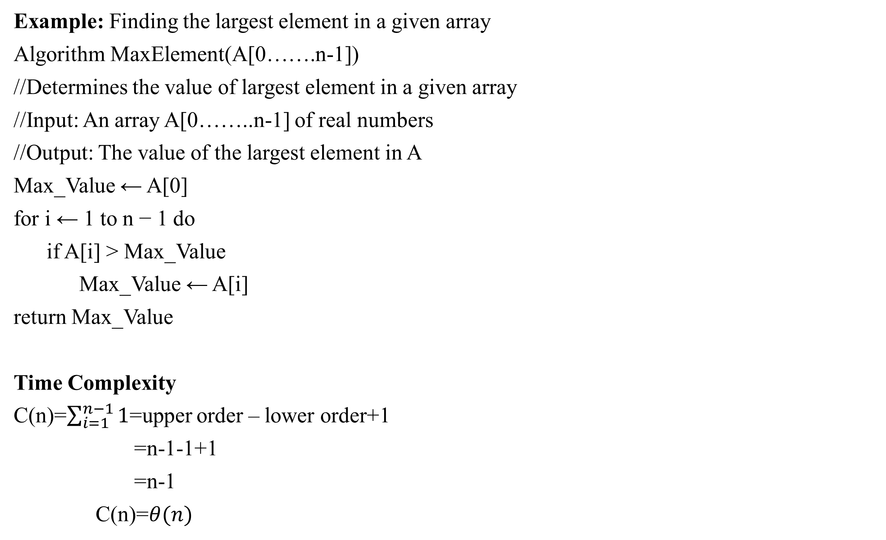
Example: Finding the largest element in a given array
Algorithm MaxElement(A[0…….n-1])
//Determines the value of largest element in a given array
//Input: An array A[0……..n-1] of real numbers
//Output: The value of the largest element in A
Max_Value ← A[0]
for i ← 1 to n − 1 do
if A[i] > Max_Value
Max_Value ← A[i]
return Max_Value
Time Complexity
C(n)=$\sum_{i=1}^{n−1}{1}$=upper order – lower order+1
=n-1-1+1
=n-1
C(n)=$θ(n)$

Slide 14
Analysis:
1. Input size: number of elements = n (size of the array)
2. Basic operation: a) Comparison b) Assignment
3. NO best, worst, average cases.
4. Let C (n) denotes number of comparisons:
Algorithm makes one comparison on each execution of the loop, which is repeated for each value of the loop’s variable i within the bound between 1 and n – 1. 5. Simplify summation using standard formulas

Slide 15
Mathematical analysis (Time Efficiency) of Recursive Algorithms
General Plan for Analyzing the Time Efficiency of Recursive Algorithms 1. Decide on a parameter (or parameters) indicating an input's size. 2. Identify the algorithm's basic operation. 3. Check whether the number of times the basic operation is executed can vary on different inputs of the same size; if it can, the worst-case, average-case, and best-case efficiencies must be investigated separately. 4. Set up a recurrence relation, with an appropriate initial condition, for the number of times the basic operation is executed. 5. Solve the recurrence or, at least, ascertain the order of growth of its solution.

Slide 16
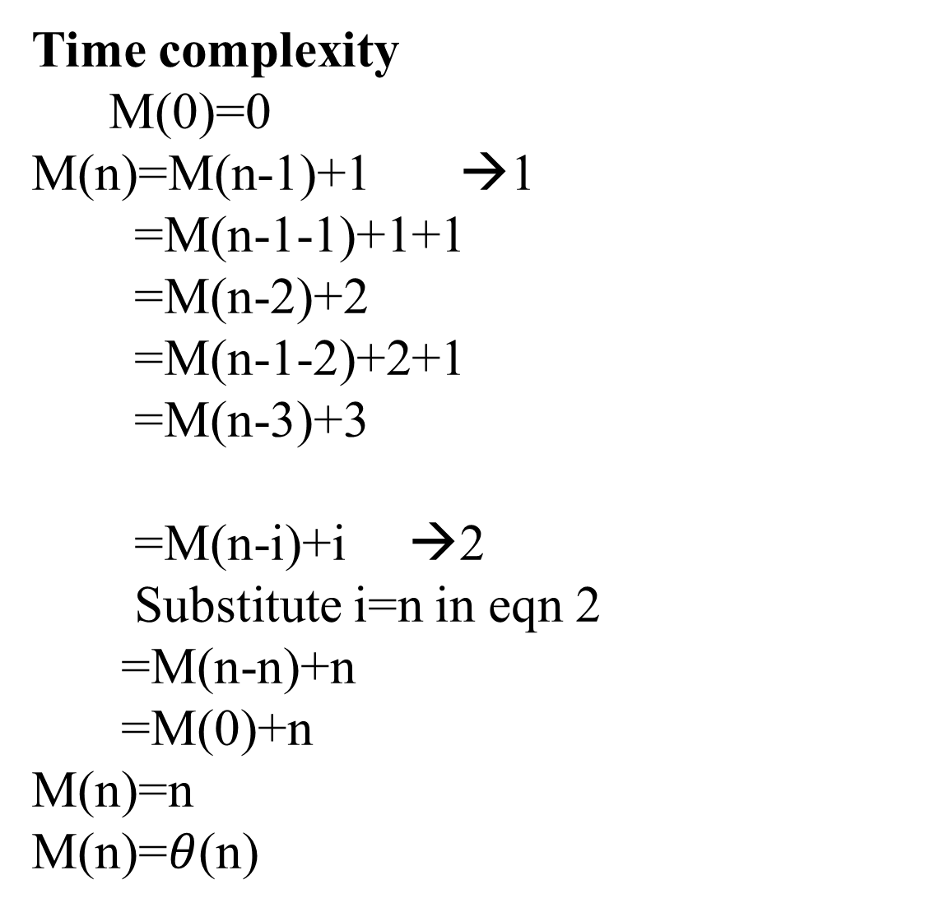
Example: To Find factorial of number
Algorithm Factorial(n)
//Computes n! recursively
//Input: n
//Output: The value of n!
if n = 0 return 1
else return F(n - 1)*n
Time complexity
M(0)=0
M(n)=M(n-1)+1 →1
=M(n-1-1)+1+1
=M(n-2)+2
=M(n-1-2)+2+1
=M(n-3)+3
=M(n-i)+i →2
Substitute i=n in eqn 2
=M(n-n)+n
=M(0)+n
M(n)=n
M(n)=$θ$(n)

Slide 17
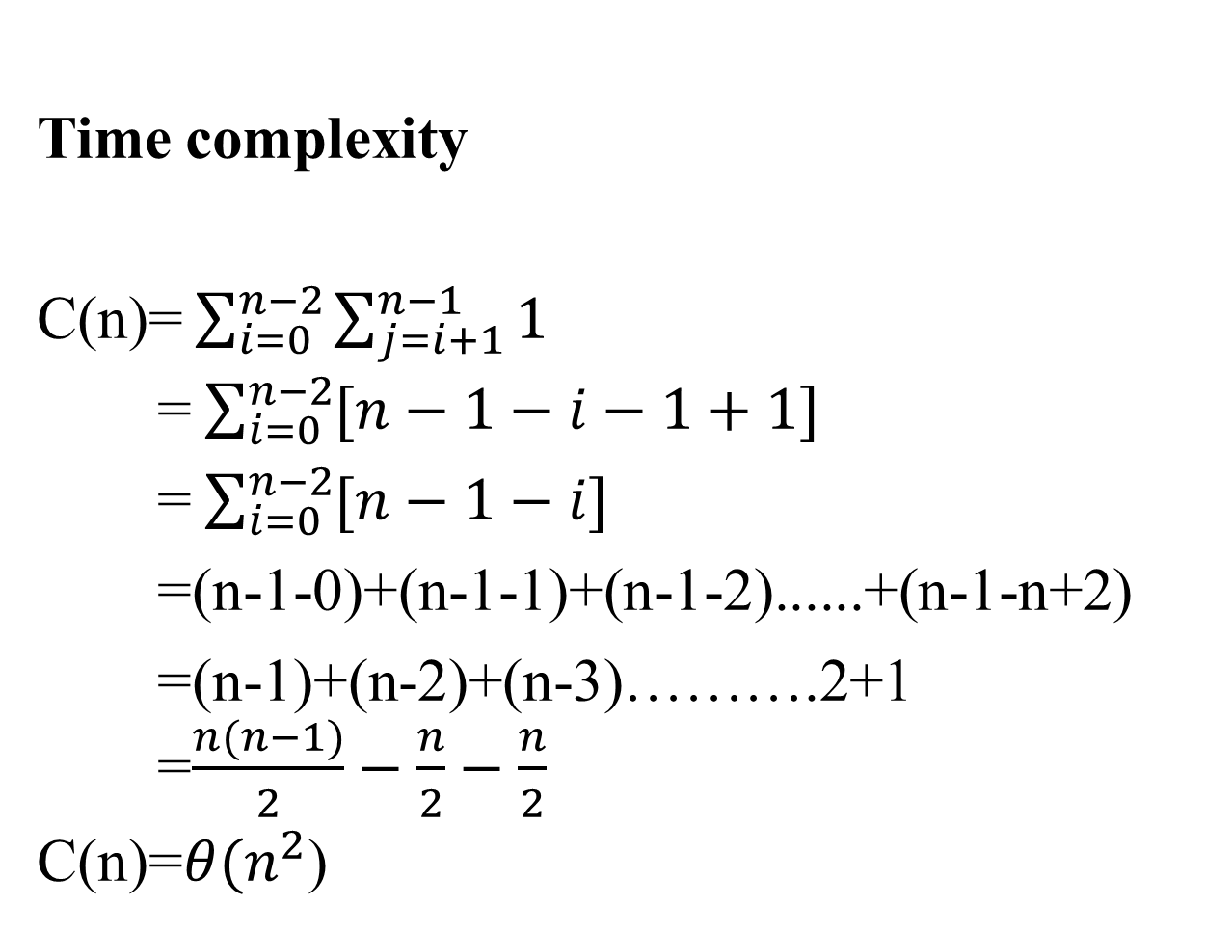
Brute Force Approaches
Selection sort Algorithm
selection sort(A[0 n-1])
//To sort the array element
//I/P: A[0 n-1]
//O/P: sorted array element
for i ←0 to n-2 do
min ←1
for j←i+1 to n-1 do
if[(A[j]<A[min])
min←j
swap A[i] and A[min]
Time complexity
C(n)= $\sum_{i=0}^{n−2}{\sum_{j=i+1}^{n−1}{1}}$
= $\sum_{i=0}^{n−2}{[n−1−i−1+1]}$
= $\sum_{i=0}^{n−2}{[n−1−i]}$
=(n-1-0)+(n-1-1)+(n-1-2)......+(n-1-n+2)
=(n-1)+(n-2)+(n-3)……….2+1
=$\frac{n(n−1)}{2}−\frac{n}{2}−\frac{n}{2}$
C(n)=$θ(n^{2}$)

Slide 18
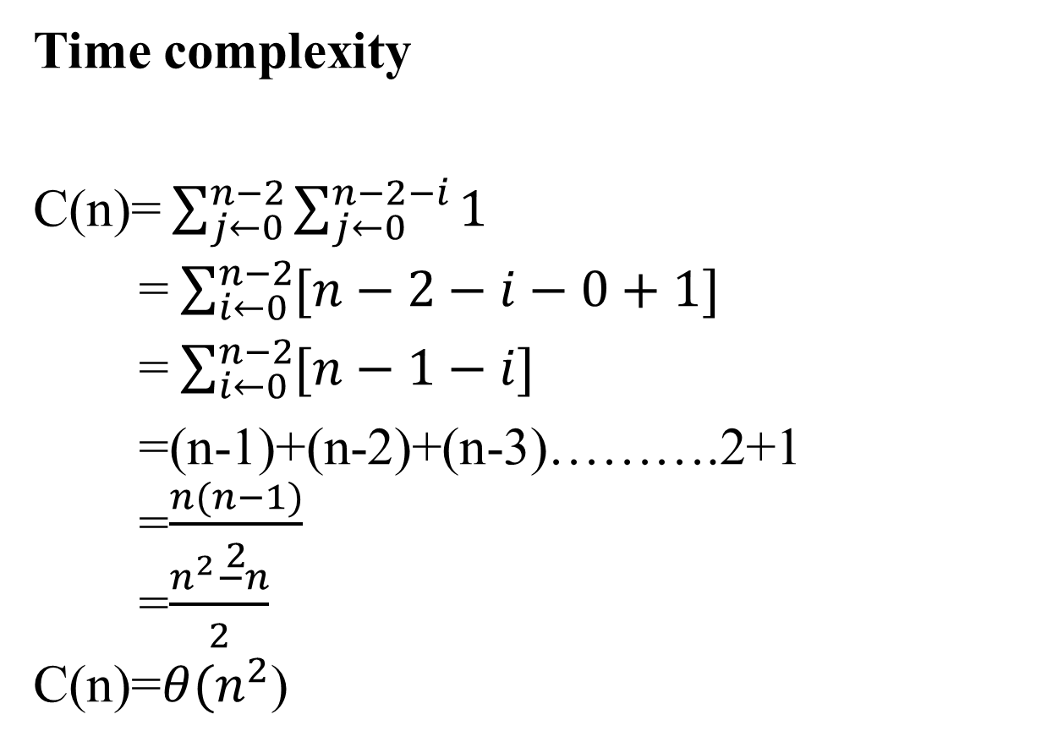
Bubble sort
Bubble sort(A[0 n-1])
//To sort the array element
//I/P: A[0 n-1]
//O/P: sorted array element
for i ←0 to n-2 do
for j←i+1 to n-1 do
if[(A[j]<A[j+1])
swap A[j] and A[j+1]
Time complexity
C(n)= $\sum_{j←0}^{n−2}{\sum_{j←0}^{n−2−i}{1}}$
= $\sum_{i←0}^{n−2}{[n−2−i−0+1]}$
= $\sum_{i←0}^{n−2}{[n−1−i]}$
=(n-1)+(n-2)+(n-3)……….2+1
=$\frac{n(n−1)}{2}$
=$\frac{n^{2}−n}{2}$
C(n)=$θ(n^{2}$)

Slide 19
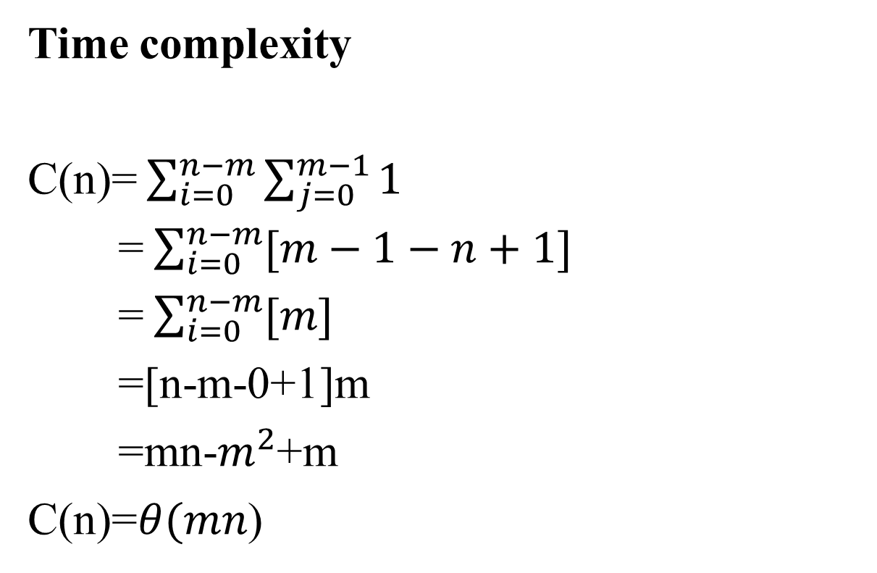
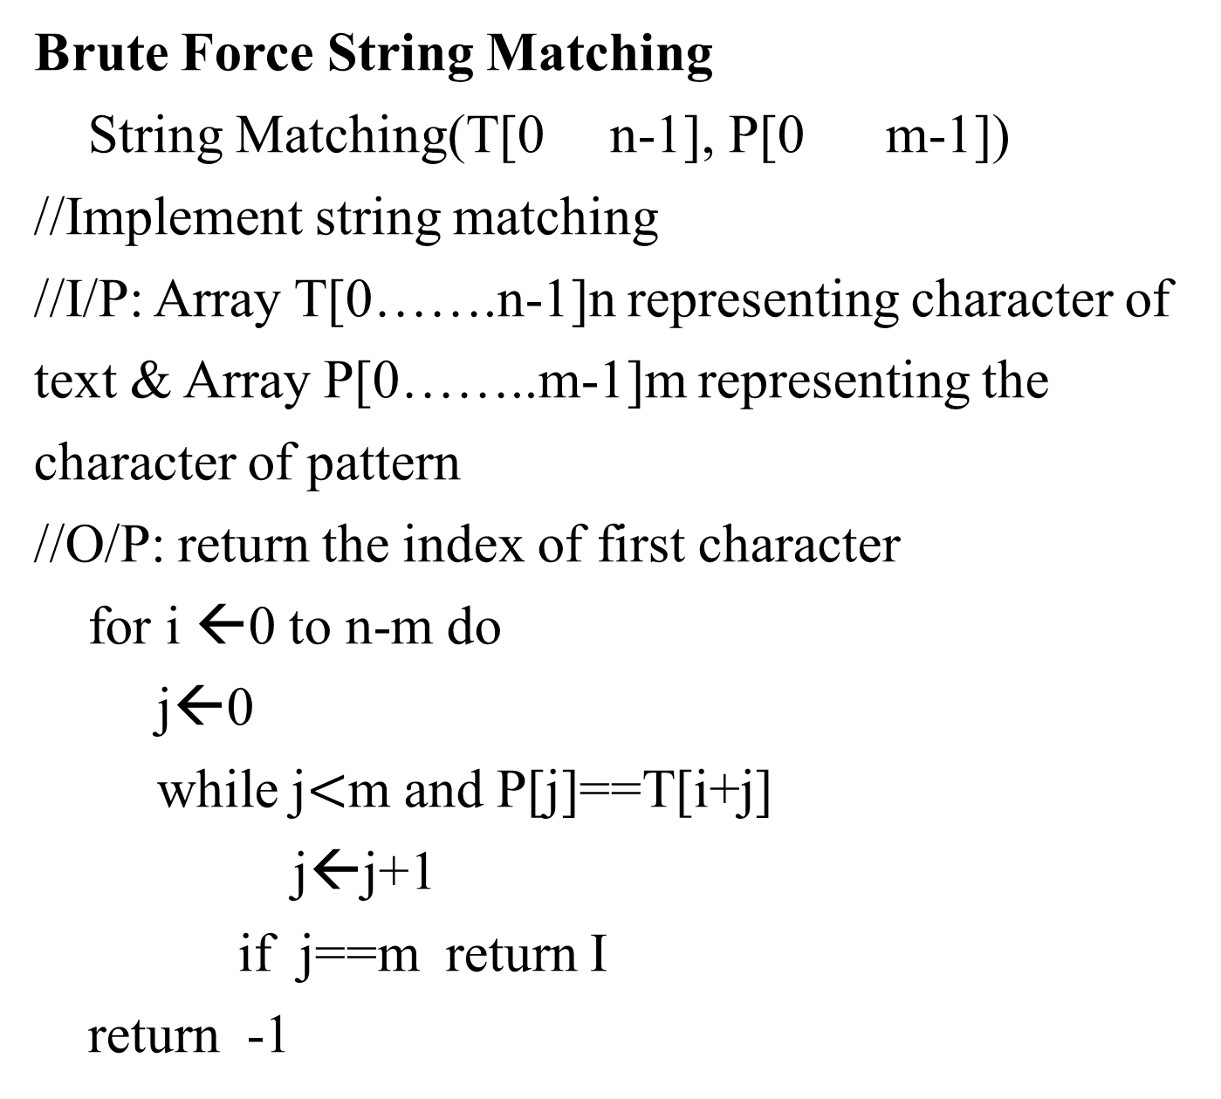
Brute Force String Matching
String Matching(T[0 n-1], P[0 m-1])
//Implement string matching
//I/P: Array T[0…….n-1]n representing character of text & Array P[0……..m-1]m representing the character of pattern
//O/P: return the index of first character
for i ←0 to n-m do
j←0
while j$<$m and P[j]==T[i+j]
j←j+1
if j==m return I
return -1
Time complexity
C(n)= $\sum_{i=0}^{n−m}{\sum_{j=0}^{m−1}{1}}$
= $\sum_{i=0}^{n−m}{[m−1−n+1]}$
= $\sum_{i=0}^{n−m}{[m]}$
=[n-m-0+1]m
=mn-$m^{2}$+m
C(n)=$θ(mn$)

